Slide 1


MS4 PROGRAM
PILOT BMP PROJECTS

Slide 2
3 Pilot Projects – MS4 Structural BMPs
#1 – Rain Garden, W-B Career & Technical CENTER, Plains Township
#2 – Stormwater Park, Plains Township
#3 – Spring Run Stream Restoration, Hanover Township

Slide 3
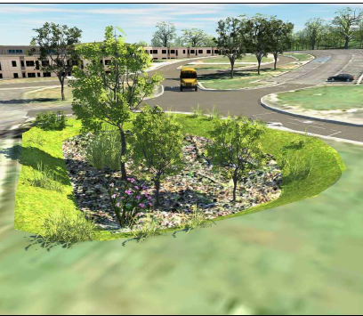
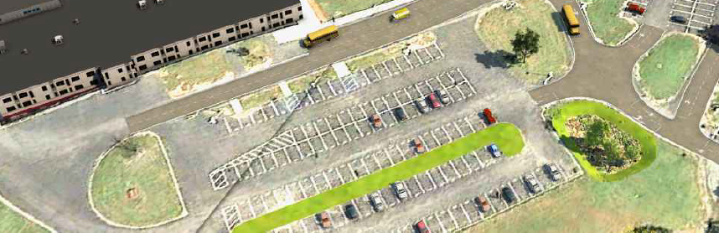
RAIN GARDEN – W-B Career & Tech Center
Visibility/ Educational/ Beautification/Property Access/ O&M/ Partnership
Construction Cost (estimated) = $50,000 to $70,000
Pollution Reduction Credit = 1,100 lbs/yr

Slide 4
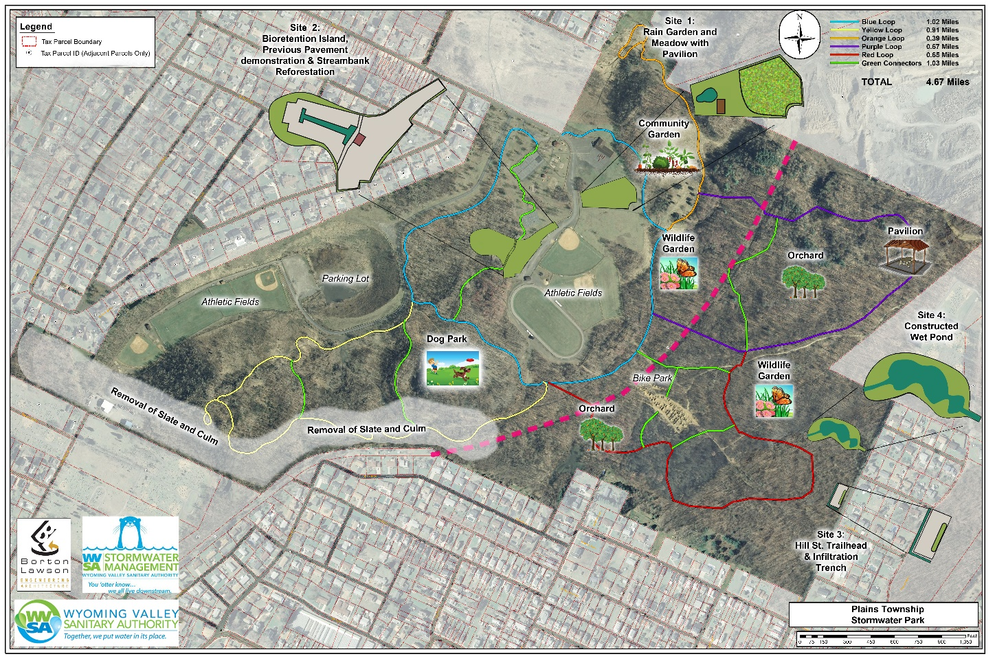
STORMWATER PARK– Plains Township
Visibility/ Educational/ Stormwater Runoff Issues/Property Access
Growing Greener Grant Awarded = $120,000
Construction Cost (estimated) = $450,000 to $550,000
Pollution Reduction Credit = 21,100 lbs/yr

Slide 5
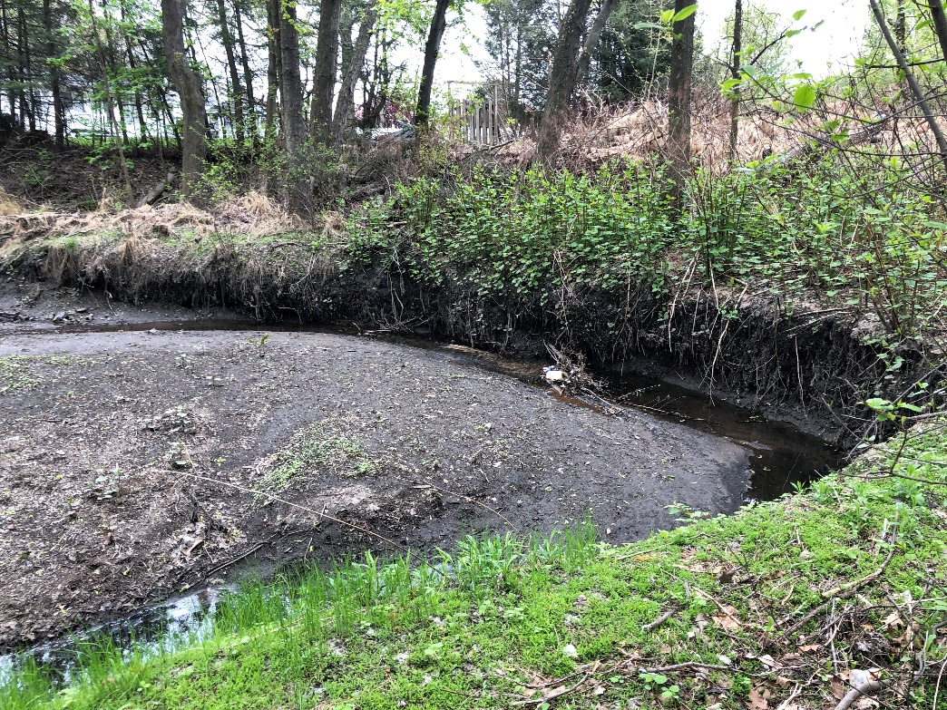
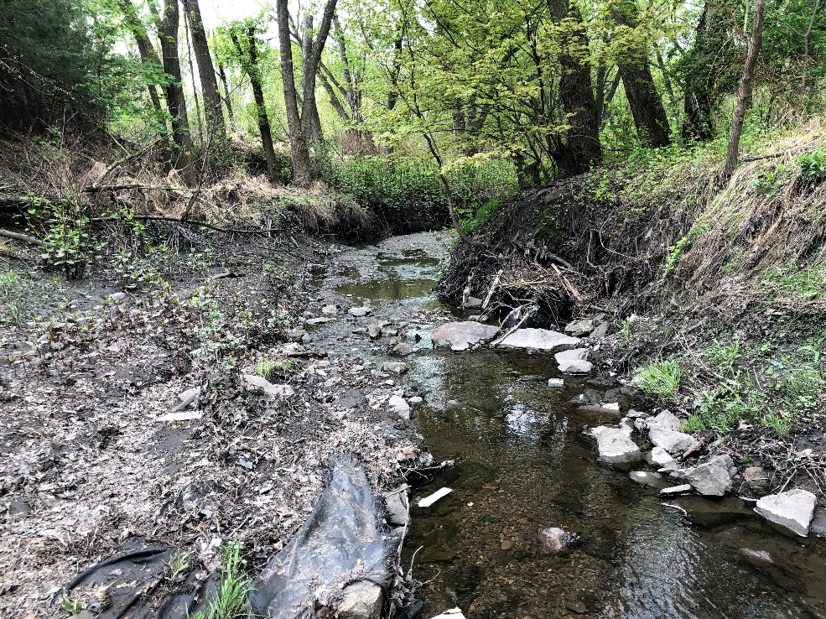
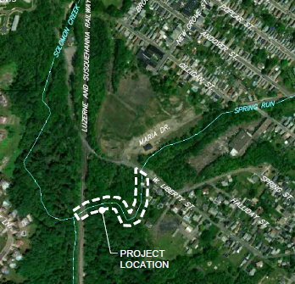
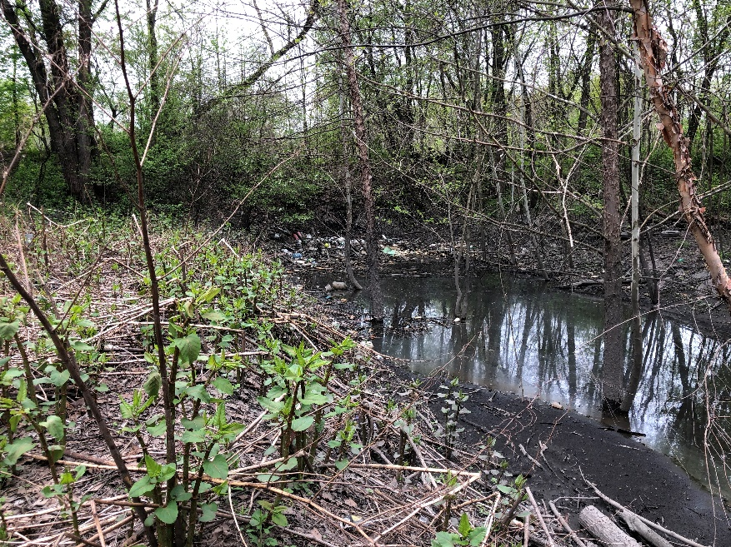
SPRING RUN STREAM RESTORATION– Hanover Township – 600 LF (linear feet)
High Pollution Reduction Impact/ Beautification/Property Access/ Environmental Restoration/ Grant Potential
Construction Cost (estimated) = $350,000 to $450,000
Pollution Reduction Credit = 27,000 lbs/yr

Slide 6
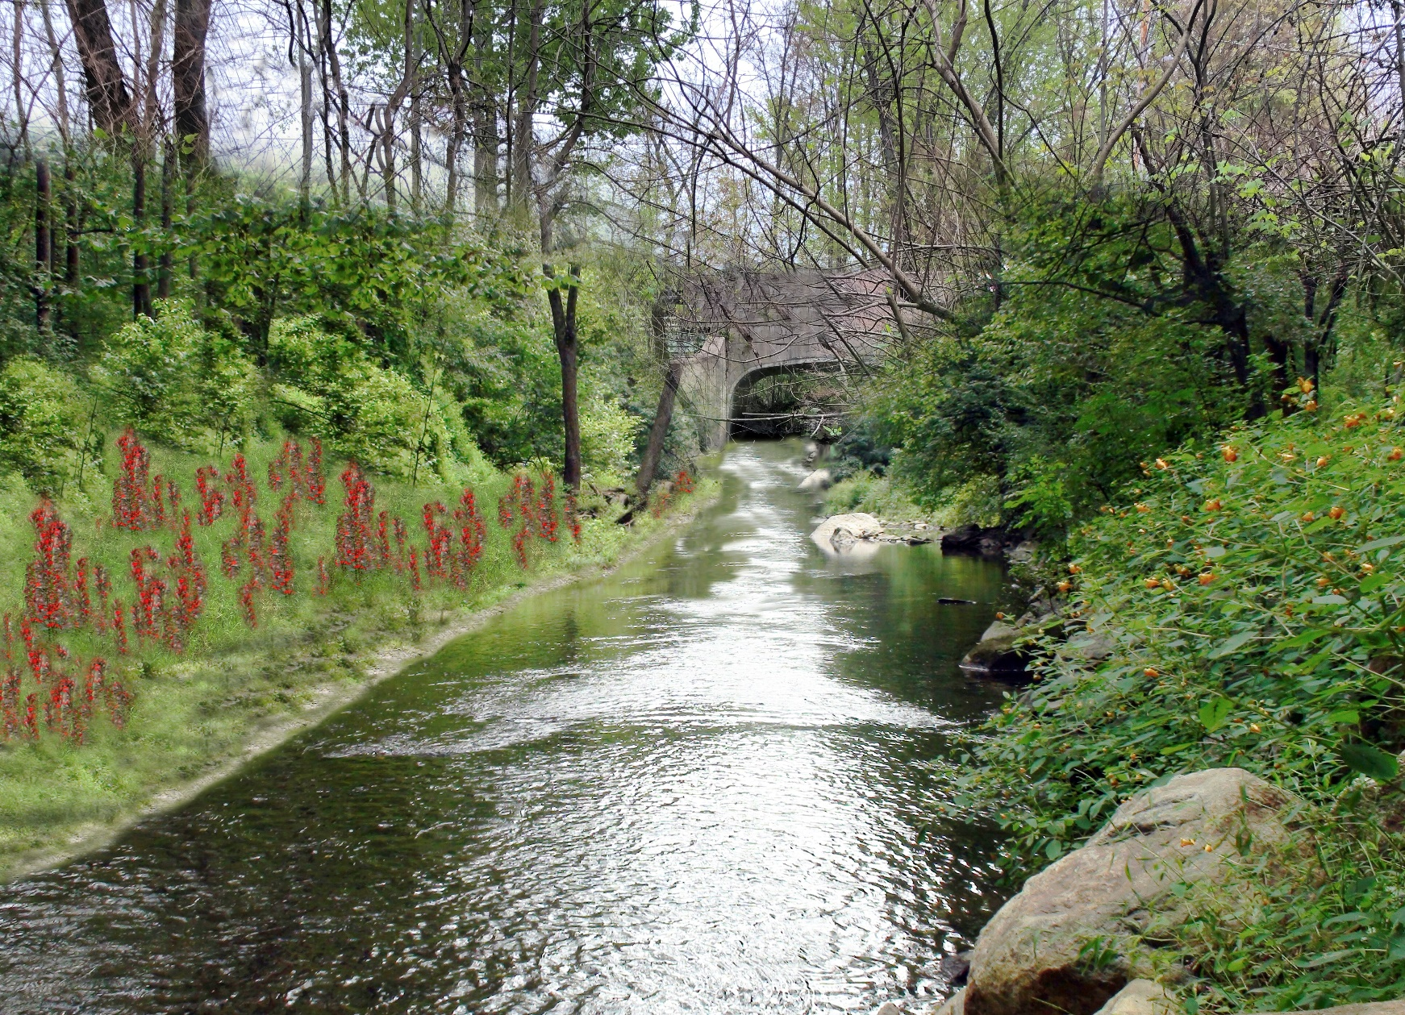
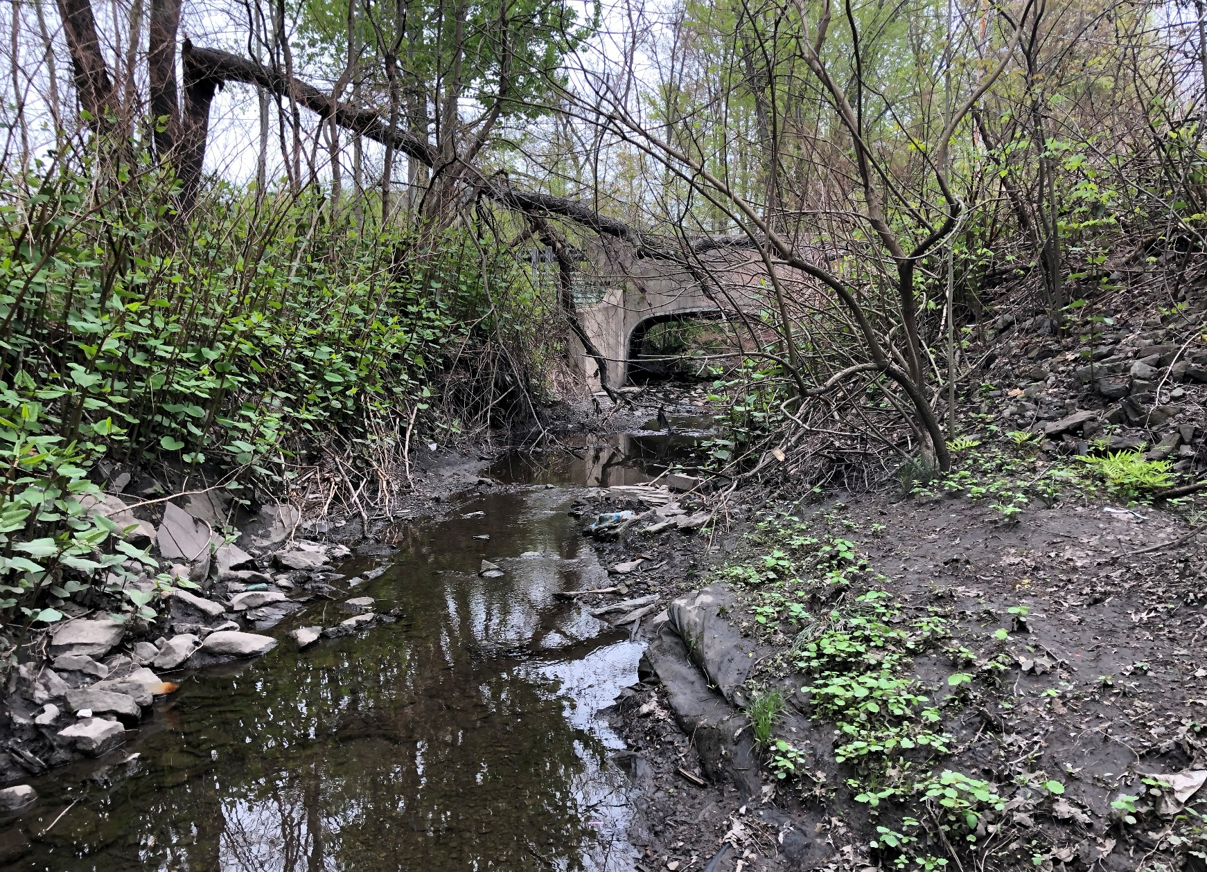
SPRING RUN STREAM RESTORATION

Slide 7
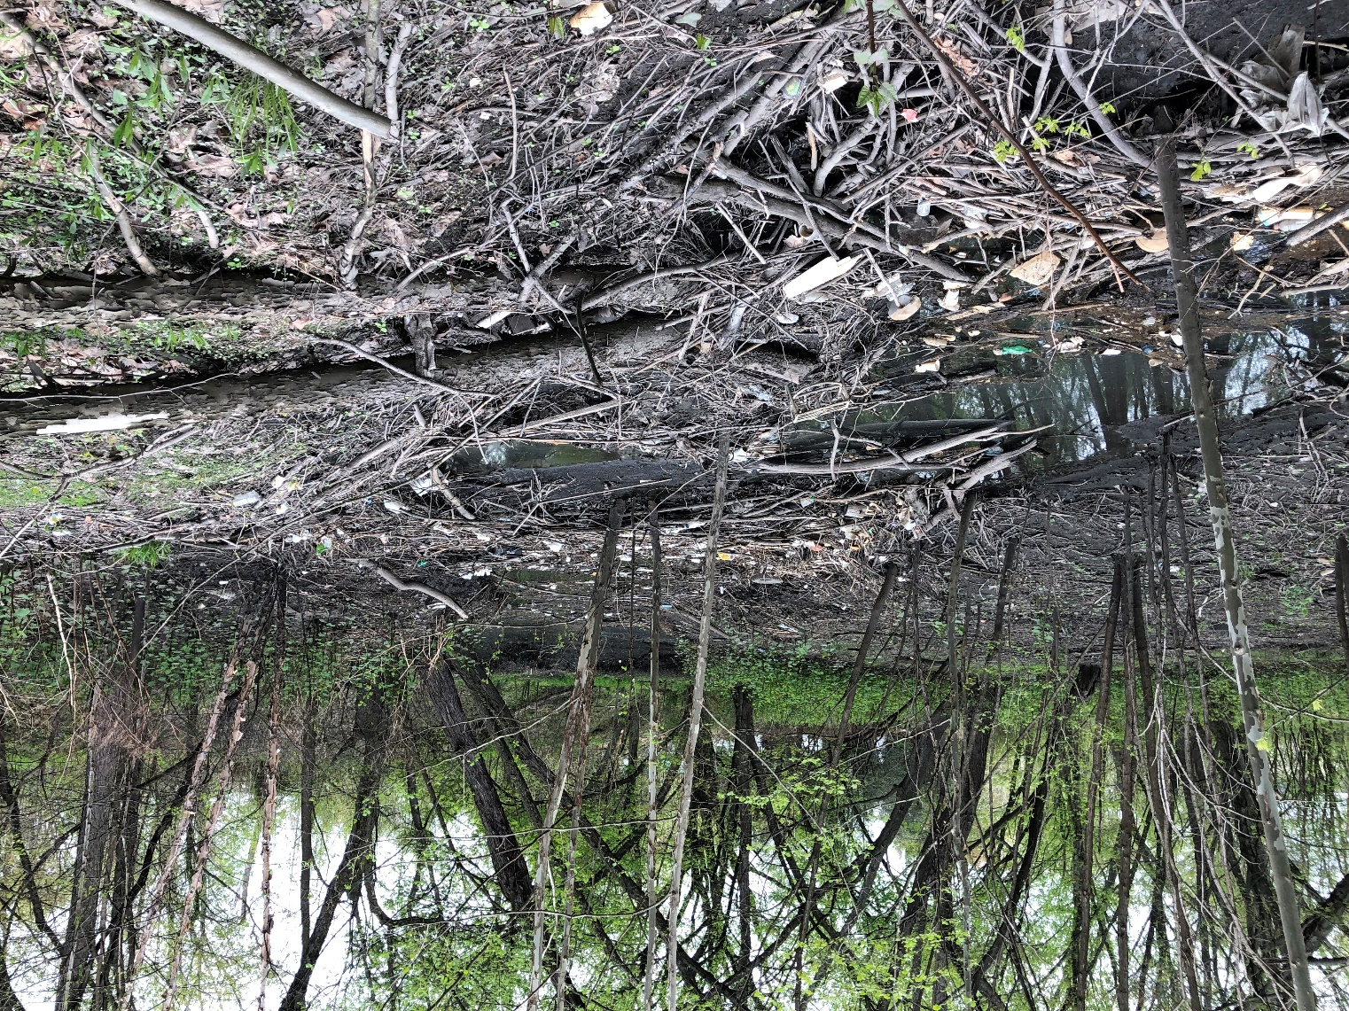
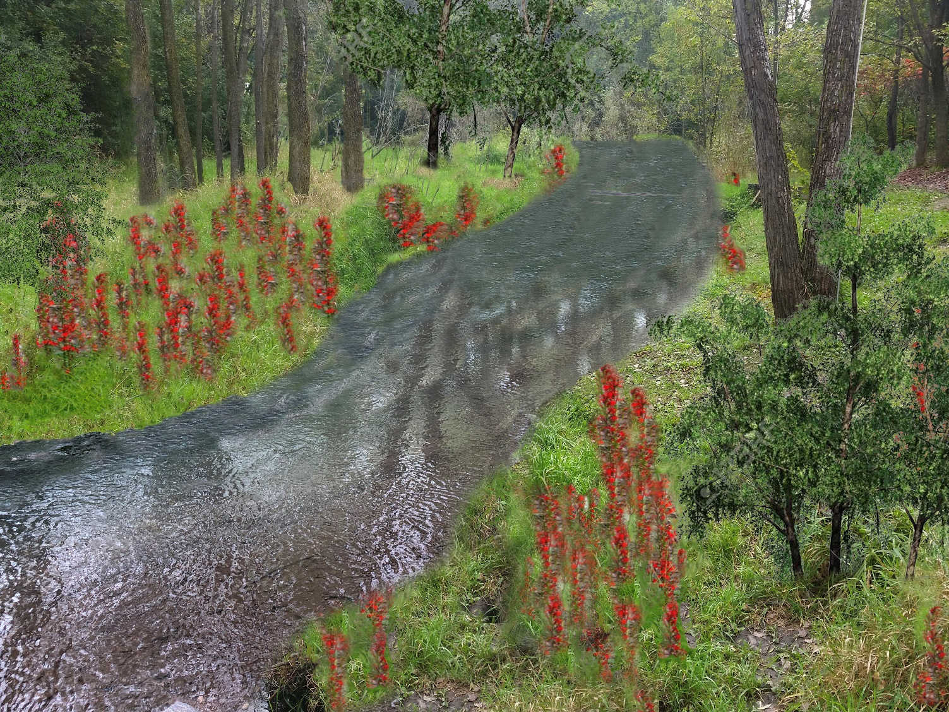
SPRING RUN STREAM RESTORATION

Slide 8
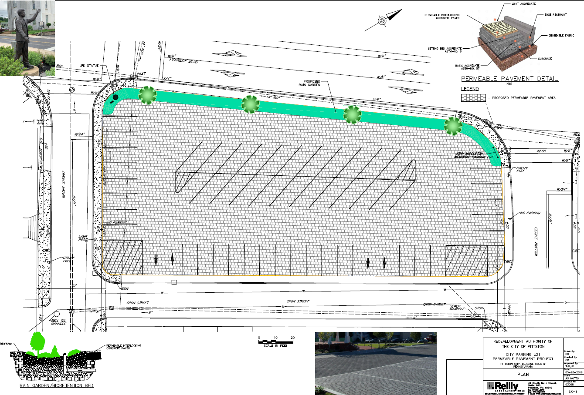
PROJECT AREAS UNDER STUDY…..
Permeable Pavement/ Pavers – YMCA Parking Lot, Pittston City

Slide 9
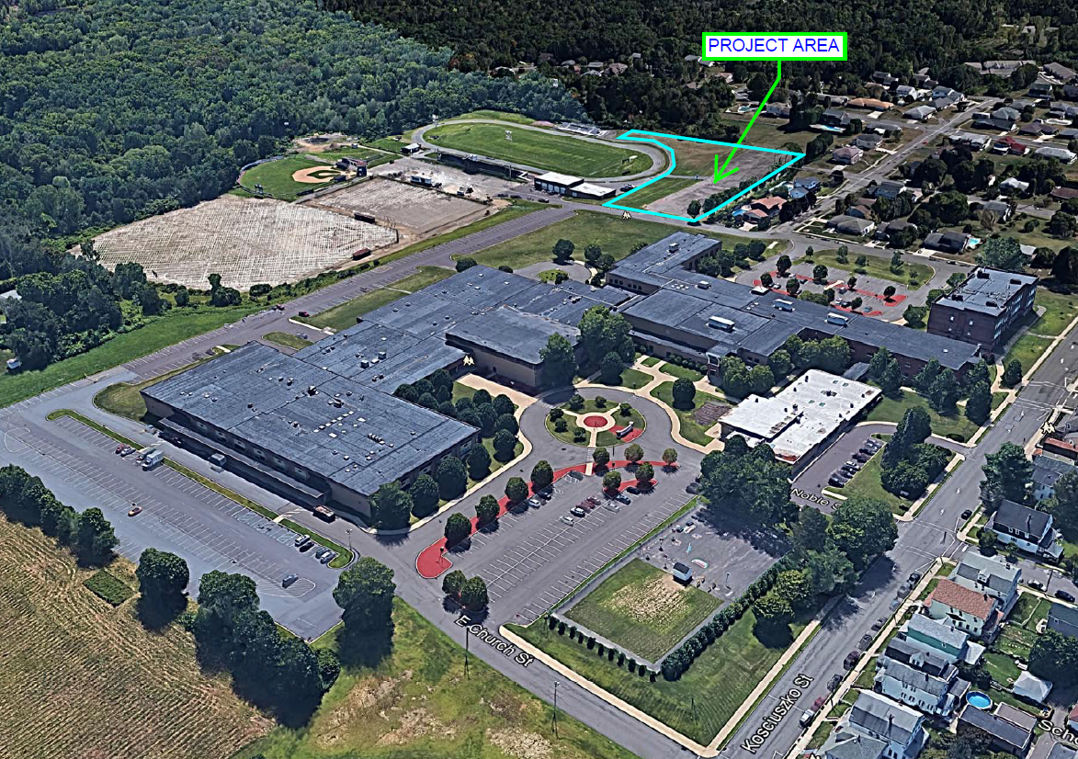
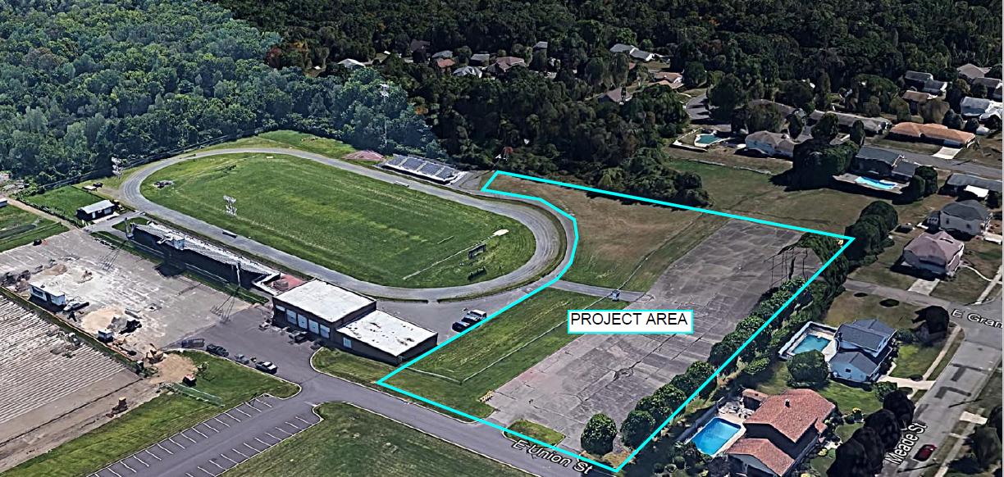
PROJECT AREAS UNDER STUDY…..
- Harveys Lake & Jackson Township – Back Mountain
- Bioswale/ Rain Garden at Nanticoke Area School Properties

